Slide 1
Weekly Writing
Prompt #1: Writing a bare bones MEAL paragraph

Slide 2
What’s going on in this picture? Tell the story…

Slide 3
Switching Modes: What is the mood of this painting? Respond in a MEAL paragraph.
What is the mood of Munch’s “The Scream” (M)
What in the painting is evidence of the mood? (E)
How does the evidence connect to the mood? (A)
Last Sentence/Conclusion (L)

Slide 4
Literary Analysis
Creative Writing allows you to create and tell the screaming figure’s story. There are no rules. Maybe he just escaped the mental hospital, maybe he’s being abducted by aliens, maybe he’s part of the illuminati…
Literary Analysis requires you use the evidence in the painting to reach a conclusion. We cannot make illogical leaps. We must stick to what is in the painting to answer the question. How do the brushstrokes, colors, objects, figures, etc. work together to create a certain mood? What is the mood?

Slide 5
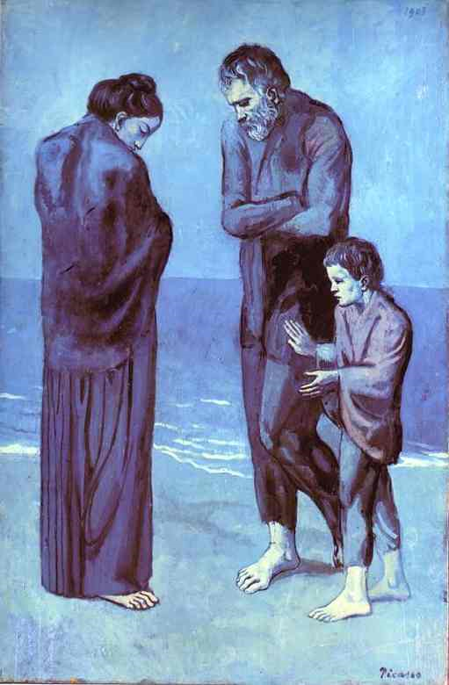
Picasso's “The Tragedy”
Write down any details that stand out to you.
Remember to stick to the evidence provided in the painting, NO ILLOGICAL LEAPS!!

Slide 6
Weekly Writing Assignment #1
What is the mood of Picasso’s “The Tragedy” (M)
What in the painting is evidence of the mood? (E)
How does the evidence connect to the mood? (A)
Last Sentence/Conclusion (L)

Slide 7
Example #1
The mood in this picture is sadness because the look and color on their face shows it. Those three people standing on the beach look cold because they fold their arms together. If the picture were to become alive, the people will probably be shivering. They might be illegal immigrants that want to get away from their country and sailed away. When they got away from their homeland, they swam to shore in another country.

Slide 8
Example #2
The mood in the Picasso painting “The Tragedy” is one of sadness or being sad. I see this mood in the painting through the colors of the painting, the body language of the people and the people’s facial expressions. The color of the picture consists of many shades of blue. Blue is generally seen as a slightly depressing, and somewhat sad, color. It is associated with sad rainy days and also being depressed/sad. The facial expressions of the people also suggest they are sad. The man in the picture is looking down with his eyes closed and he is frowning. This shows sadness and possibly missing someone or something. This may be why he is sad. The woman in the paining also has her eyes closed and is turning away, almost as if to try and get away from what is making her sad. And the boy has a genuine look of sadness on his face. The body language is one last way I identified the mood of this painting. The man is huddled up like he is cold and possibly sad. The woman is the same way. But the child shows longing and also curiosity as to why the parents have the body language they have. This is the mood I see in Picasso’s painting, “The Tragedy”

Slide 9
Take A Look At The Following Paragraphs: What did this student do well? What aspects of MEAL should this student practice further?
By analyzing the details in Pablo Picasso’s “The Tragedy,” the illustrator intended to create a sad mood. People might think this because when they see the picture the first thing they see is a poor family huddled together, by seeing this it could make them feel upset.

Slide 10
Take A Look At The Following Paragraphs: What did this student do well? What aspects of MEAL should this student practice further?
The entire painting is blue which gives you the feeling of depression and unhappiness. The family looks poor and cold. That gave me the feeling that it could be the past following him or catching up to him to tear him down.

Slide 11
Take A Look At The Following Paragraphs: What did this student do well? What aspects of MEAL should this student practice further?
Another piece of evidence backing up the mood is the abstract or fantasy like look of the painting. It suggests surrealism and nightmarish qualities from the wavy lines blending with each other and the straight lines leading towards the man in the foreground.

Slide 12
Take A Look At The Following Paragraphs: What did this student do well? What aspects of MEAL should this student practice further?
This is how the painting is showing a sad and gloomy mood.
For these reasons Picasso’s painting is depressing.

