Slide 1
Definition:
Symbol: It is when something concrete (something you can touch, see, smell, hear, or taste) represents something abstract (an idea).

Slide 2
Three Level of Symbolism
Level 3: What universal ideas could those details represent?
Level 2: What could these details represent either in history or society?
Level 1: What are some of the literal details of the symbol/story?

Slide 3
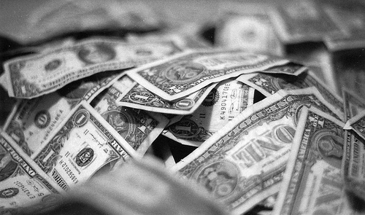
Symbols in everyday life…
Dollar Bill

Slide 4
Working Through Symbolism
Level 3: Universally, money represents the idea of wealth, success, desire.
Level 2: American Society uses the dollar bill as its currency, it acts as a material to trade with, to make purchases.
Level 1: Concrete/literal: A dollar bill is a piece of green paper

Slide 5
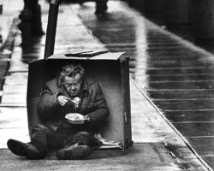
Something to think about…
Remember, symbols can have more than one meaning!
What could money symbolically represent to a self-made millionaire?
What could money symbolically represent to a homeless person?

Slide 6
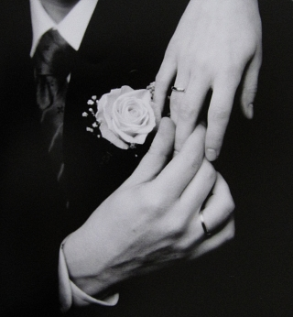
Wedding Ring

Slide 7
Let’s do this one together…
Level 3: What universal ideas could those details represent?
Level 2: What could these details represent either in history or society?
Level 1: What are some of the literal details of the symbol?
What does a wedding ring symbolize to a newly married couple? To a couple that has been married for fifty years?

Slide 8
Symbolic situations in life…
Thumbs up
Coal in your Christmas Stocking
Giving or receiving flowers
What ABSTRACT ideas could these situations/actions represent?

Slide 9
Motif
A MOTIF IS…
When we are talking about a motif within a novel: Any reoccurring object, symbol, phrase, idea, etc. that helps you to understand the theme (message of the novel). Sometimes a motif IS a theme.

Slide 10
Theme
Theme is the central idea in a work of literature.
It is the point of the story, so to speak. It is the ideas we can think about and apply to our own lives.
The author’s purpose is the theme

Slide 11
Theme vs. Topic
The main idea of a story is a theme. It is a STATEMENT about the life, society, human nature, or the human condition.
A theme is different from a topic because it is an understood statement.

Slide 12
Theme vs. Topic
Theme
“Love can make us better people
“Jealousy can be very destructive”
Justice has multiple sides; what is fair to some is unfair for others
“War can tear families apart”
The future is not an escape route, problems and concerns are still present”.

Slide 13
Theme vs. Moral
A theme is an observation on life or the human condition, while a moral is advice on how one should live their life.

